Slide 1
The Age of Promise
God’s Covenant with Abraham

Slide 2
The Pattern of the Ages
How did God receive worship during this time?
What was mankind responsible for?
How did mankind fulfill that responsibility?
What did God change?

Slide 3
The Story so Far
God gave man a conscience, so he would know right from wrong

Slide 4
The Story so Far
God gave man a conscience
God gave man a pattern of worship, so he could worship God rightly

Slide 5
The Story so Far
God gave man a conscience
God gave man a pattern of worship
God gave man human government, so he could enforce right and wrong

Slide 6
The Story so Far
God gave man a conscience
God gave man a pattern of worship
God gave man human government
God separated man’s languages, so that everyone would not follow the same wrong path

Slide 7
The Story so Far
God gave man a conscience
God gave man a pattern of worship
God gave man human government
God separated man’s languages

Slide 8
The Abrahamic Covenant
Select passages from Genesis 12; 13; 15; 17; 22; 26; 28; 35
Notes:
God promised the Abrahamic Covenant at least eight times over three generations. (1) when God called Abram out of Ur (12:1-4); (2) after Abram separated from Lot (13:14-17); (3) after Abram rescued Lot from a coalition of kings (Gen 15:1-18); (4) when God announced that Isaac would be born (Gen 17:1-22); (5) after Abraham offered Isaac as an offering (Gen 22:15-17). God also restated the covenant to Isaac (Gen 26:2-5) and to Jacob (Gen 28:13-15; 35:11-13)

Slide 9
The Need for the Abrahamic Covenant
After the flood, God had given every nation equal opportunity to follow him.
Unfortunately, even after God confused people’s languages, the worship of the true God was gradually being abandoned.
So God chose to bless one man in a special way and the world through that man.
That man was Abraham.
Notes:
See Romans 1:18-20.

Slide 10
The Promises of the Abrahamic Covenant
Descendants

Slide 11
Descendants
God would give Abraham countless descendants
“I will make your offspring as the dust of the earth, so that if one can count the dust of the earth, your offspring also can be counted.” (Genesis 13:16, ESV)

Slide 12
Descendants
God would give Abraham countless descendants
“And behold, the word of the Lord came to him: “This man shall not be your heir; your very own son shall be your heir.” And he brought him outside and said, “Look toward heaven, and number the stars, if you are able to number them.” Then he said to him, “So shall your offspring be.” And he believed the Lord, and he counted it to him as righteousness.” (Genesis 15:4–6, ESV)

Slide 13
Descendants
God would give Abraham countless descendants
“that I may make my covenant between me and you, and may multiply you greatly.”” (Genesis 17:2, ESV)

Slide 14
Descendants
God would give Abraham countless descendants
“I will surely bless you, and I will surely multiply your offspring as the stars of heaven and as the sand that is on the seashore. And your offspring shall possess the gate of his enemies,” (Genesis 22:17, ESV)
God repeated this to Isaac (Gen 26:4) and Jacob (Gen 28:14; 35:11)

Slide 15
Descendants
God would give Abraham countless descendants
God would make a great nation come from Abraham
“And I will make of you a great nation, and I will bless you and make your name great, so that you will be a blessing.” (Genesis 12:2, ESV)
Notes:
This great nation is, of course, the Jews

Slide 16
Descendants
God would give Abraham countless descendants
God would make a great nation come from Abraham
“And God said to him [Jacob], “I am God Almighty: be fruitful and multiply. A nation and a company of nations shall come from you, and kings shall come from your own body.” (Genesis 35:11, ESV)
Notes:
This great nation is, of course, the Jews

Slide 17
Descendants
God would make many other nations and kings come from Abraham
“Behold, my covenant is with you, and you shall be the father of a multitude of nations. No longer shall your name be called Abram, but your name shall be Abraham, for I have made you the father of a multitude of nations. I will make you exceedingly fruitful, and I will make you into nations, and kings shall come from you.” (Genesis 17:4–6, ESV)
Notes:
From Abraham also came the Ishmaelites, Midianites, Edomites, and several other peoples.

Slide 18
The Promises of the Abrahamic Covenant
Descendants
Land

Slide 19
Land
God would give Abraham the Land of Canaan
“The Lord said to Abram, after Lot had separated from him, “Lift up your eyes and look from the place where you are, northward and southward and eastward and westward, for all the land that you see I will give to you and to your offspring forever.” (Genesis 13:14–15, ESV)

Slide 20
Land
God would give Abraham the Land of Canaan
“And he said to him, “I am the Lord who brought you out from Ur of the Chaldeans to give you this land to possess.””…“On that day the Lord made a covenant with Abram, saying, “To your offspring I give this land, from the river of Egypt to the great river, the river Euphrates, the land of the Kenites, the Kenizzites, the Kadmonites,” (Genesis 15:7, 18–19, ESV)

Slide 21
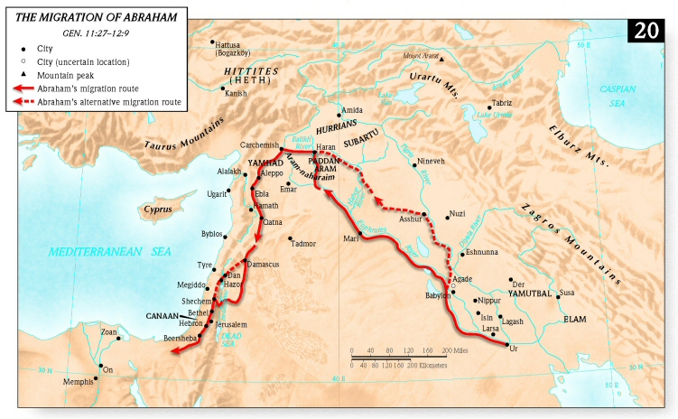

Slide 22
Land
God would give Abraham the Land of Canaan
God would give him this land forever
“for all the land that you see I will give to you and to your offspring forever.” (Genesis 13:15, ESV)

Slide 23
Land
God would give Abraham the Land of Canaan
God would give him this land forever
“And I will give to you and to your offspring after you the land of your sojournings, all the land of Canaan, for an everlasting possession, and I will be their God.”” (Genesis 17:8, ESV)
God restates this to Isaac (Gen 26:2-3) and Jacob (Gen 28:13; 35:12)

Slide 24
The Promises of the Abrahamic Covenant
Descendants
Land
Blessing

Slide 25
Blessing
God would bless Abraham
“And I will make of you a great nation, and I will bless you and make your name great, so that you will be a blessing.” (Genesis 12:2, ESV)

Slide 26
Blessing
God would bless Abraham
“I will surely bless you, and I will surely multiply your offspring as the stars of heaven and as the sand that is on the seashore. And your offspring shall possess the gate of his enemies,” (Genesis 22:17, ESV)

Slide 27
Blessing
God would bless Abraham
God would bless Abraham’s Family
Sarah Gen 17:16
Ishmael Gen 16:10; 17:20
Isaac Gen 26:3
Jacob Gen 28:14

Slide 28
Blessing
God would bless Abraham
God would bless Abraham’s Family
God would bless the entire world through Abraham
“I will bless those who bless you, and him who dishonors you I will curse, and in you all the families of the earth shall be blessed.” (Genesis 12:3, ESV)

Slide 29
Blessing
God would bless Abraham
God would bless Abraham’s Family
God would bless the entire world through Abraham
“and in your offspring shall all the nations of the earth be blessed, because you have obeyed my voice.” (Genesis 22:18, ESV)

